Slide 1
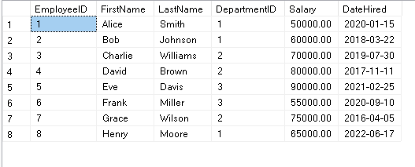
-- TASK FOR 24TH APRIL 2025 - SQL CHALLENGES
-- Creation of Two Tables
-- First Table Employees1
CREATE TABLE Employees1 (
EmployeeID INT PRIMARY KEY,
FirstName VARCHAR(50),
LastName VARCHAR(50),
DepartmentID INT,
Salary DECIMAL(10, 2),
DateHired DATE,
FOREIGN KEY (DepartmentID) REFERENCES
Departments(DepartmentID);
OUTPUT:

Slide 2
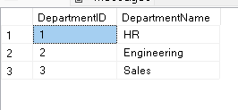
-- Second Table Departments1
CREATE TABLE Departments1 (
DepartmentID INT PRIMARY KEY,
DepartmentName VARCHAR(100)
);
OUTPUT:

Slide 3
-- I have worked on how to solve the following SQL Interview
Questions:
-- Part 1: Find the top 3 highest-paid
employees in each department.
-- HOW I worked on this query:
-- To start with I joined both the tables –
Employees1 and Departments1
SELECT
e.EmployeeID,
e.FirstName,
e.LastName,
e.DepartmentID,
e.Salary,
e.DateHired,
d.DepartmentName
FROM Employees1 as e
JOIN Departments1 as d
ON e.DepartmentID = d.DepartmentID

Slide 4
-- Then I created a rank of the employees based on the salary and
department
SELECT
e.EmployeeID,
e.FirstName,
e.LastName,
e.DepartmentID,
e.Salary,
e.DateHired,
d.DepartmentName,
ROW_NUMBER () OVER (PARTITION BY d.DepartmentID ORDER BY e.salary DESC ) AS rank
FROM Employees1 as e
JOIN Departments1 as d
ON e.DepartmentID = d.DepartmentID

Slide 5
-- To arrive at three highest paid employees in each department, I
created Ranked_Employee CTE and solved this query
With Ranked_Employee AS
(SELECT
e.EmployeeID, e.FirstName, e.LastName, e.DepartmentID, e.Salary,
e.DateHired,d.DepartmentName,
ROW_NUMBER () OVER (PARTITION BY d.DepartmentID ORDER BY e.salary DESC ) AS rank
FROM Employees1 as e
JOIN Departments1 as d
ON e.DepartmentID = d.DepartmentID)
SELECT EmployeeID,
FirstName, LastName, DepartmentID, Salary, DateHired, DepartmentName
FROM Ranked_Employee
WHERE rank = 1;

Slide 6
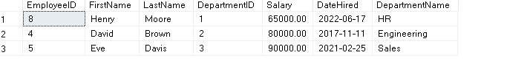
OUTPUT:

Slide 7

-- Part 2: Find the average salary of employees hired in last 5 years.
with cte_Employees AS
(SELECT EmployeeID,
CONCAT(FirstName,' ',LastName) AS full_name,
salary,
DateHired
FROM Employees1)
SELECT
ROUND(AVG(salary),2) AS Avg_Salary
FROM cte_Employees
WHERE DateHired >= DATEADD(YEAR, -5, getdate())
ORDER BY Avg_Salary;
OUTPUT:

Slide 8
-- Part 3: Find the employees whose salary is less than the average salary of employees
hired in the last 5 years.
-- Firstly I worked on the query of employees who were hired in the last five years by
creating cte_employees, followed it by average salary of employees (avg_salary_CTE) who
were hired in the last five years and finally compared it with the employees whose
salaries are less than the average salary of all employees.
with cte_Employees AS
(
SELECT EmployeeID,
CONCAT(FirstName,' ',LastName) AS full_name,salary,
DateHired
FROM Employees1
WHERE DateHired >= DATEADD(YEAR, -5, GETDATE())
),
avg_salary_CTE AS (
SELECT AVG(salary) as Avg_Salary
FROM cte_Employees
)
SELECT
ae.EmployeeID,
ae.full_name,
ae.Salary,
ase.Avg_Salary
FROM cte_Employees AS ae
CROSS JOIN avg_salary_CTE AS ase
WHERE ae.salary < ase.Avg_Salary;

Slide 9
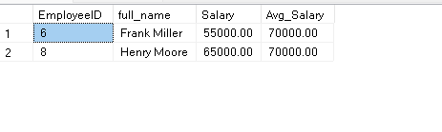
OUTPUT:

Slide 10
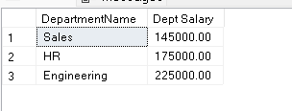
-- Part 4 – Department-wise salary
SELECT d.DepartmentName,
SUM(e.salary) AS [Dept Salary]
FROM Employees1 AS e
JOIN Departments1 AS d ON d.DepartmentID = e.DepartmentID
GROUP BY d.DepartmentName
ORDER BY [Dept Salary];
OUTPUT:

Slide 11
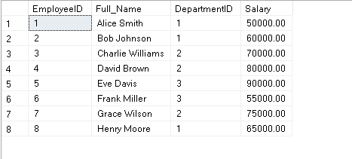
-- Part 5 - Creation of VIEW in SQL - Employee Information
CREATE VIEW employee_info AS
SELECT EmployeeID,
CONCAT(FirstName,' ',LastName) as Full_Name,
DepartmentID, Salary
FROM Employees1
SELECT * FROM employee_info;
OUTPUT:

